Slide 1
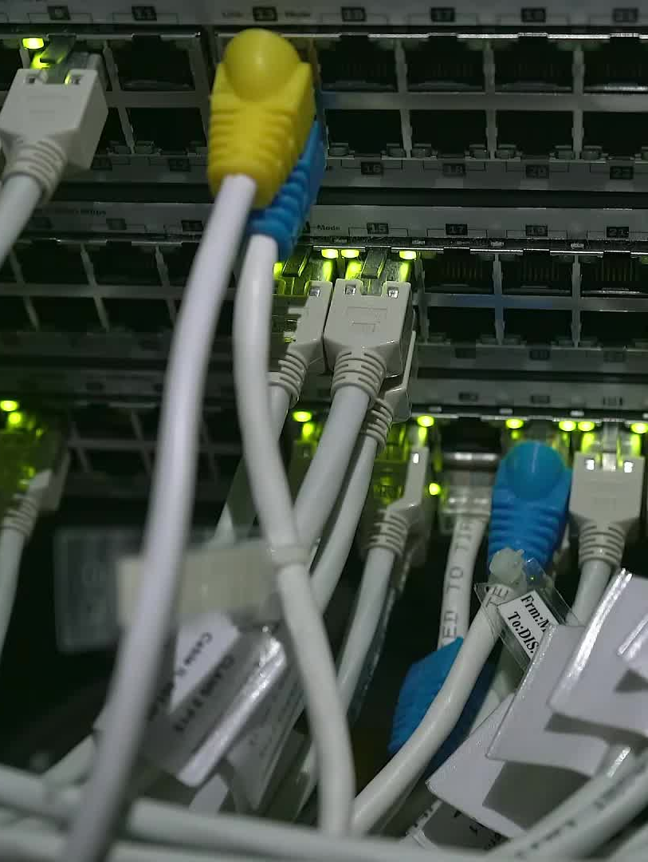
IoT SYSTEMS SECURITY
By
FAITH CHELUGET NAMAEMBA
WELCOME ID: 26047507

Slide 2
IoT Systems Security
Introduction to the Activity
Purpose of the Activity
The activity strengthened understanding of C programming and pseudo-random number generation used in IoT security.
These concepts are important because secure systems depend on reliable random values for protection mechanisms.
Importance in IoT Security
Random number generation supports encryption, secure communication, and authentication in IoT systems.
Without secure randomness, connected devices become vulnerable to cyber attacks.
Programming Skills Developed
The tasks improved understanding of loops, arrays, conditions, counters, and statistical analysis.
These programming concepts are widely used in software development and cyber security.
Slide 1 | MSc Cyber Security – IoT Systems Security

Slide 3
Mean Test
Generating 1000 Random Numbers
Task Description
The program generated 1000 pseudo-random numbers between 0 and 9. The numbers were created using the provided formula without any
modifications.
Mean Calculation
The generated numbers were summed and divided by 1000 to calculate the mean. This helped analyse the average distribution of the generated values.
Expected Output
The result was expected to be close to 4.5 because the numbers are evenly distributed. A value close to 4.5 confirms balanced random generation.
Sample Output
Mean of 1000 random numbers: 4.48. This output demonstrated that the generated numbers were statistically close to the expected average.
Slide 2 | MSc Cyber Security – IoT Systems Security

Slide 4
Frequency Test
Counting Digit Occurrence
Task Description
The program generated 10,000 random numbers between 0 and 9. The purpose was to analyse how frequently each digit appeared.
Using Arrays
Arrays counted how many times each digit appeared. This allowed efficient storage and tracking of occurrence frequencies.
Expected Distribution
Each digit should appear close to 10 percent of the total numbers. An even distribution indicates that the random number generator is functioning
correctly.
Sample Output
0 occurred 1003 times, 1 occurred 987 times, and 9 occurred 995 times. These values showed that the frequencies were relatively balanced.
Slide 3 | MSc Cyber Security – IoT Systems Security

Slide 5
Odd-Even Test
Grouping Numbers into Odd and Even
Task Description
The generated numbers were divided into odd and even groups. Conditional statements were used to determine the category of each number.
Counting Results
Conditional statements counted odd and even values separately. The counters increased depending on whether a number was odd or even.
Expected Result
The final output should show approximately 50 percent odd and 50 percent even values. This confirms balanced random generation.
Sample Output
Odd Numbers: 5012 | Even Numbers: 4988. The results showed that the odd and even values were almost equally distributed.
Slide 4 | MSc Cyber Security – IoT Systems Security

Slide 6
Serial Test
Generating Random Number Pairs
Task Description
The program generated 10,000 random number pairs such as 02, 14, and 87. This helped analyse patterns within grouped random values.
Using Arrays for Pairs
Arrays counted occurrences of pairs from 00 to 99. Each pair was tracked to determine its frequency of occurrence.
Expected Result
Each pair should appear close to 1 percent of the total generated pairs. Balanced pair distribution suggests reliable random generation.
Sample Output
00 occurred 102 times | 99 occurred 101 times. The output confirmed that pair occurrences were close to expected values.
Slide 5 | MSc Cyber Security – IoT Systems Security

Slide 7
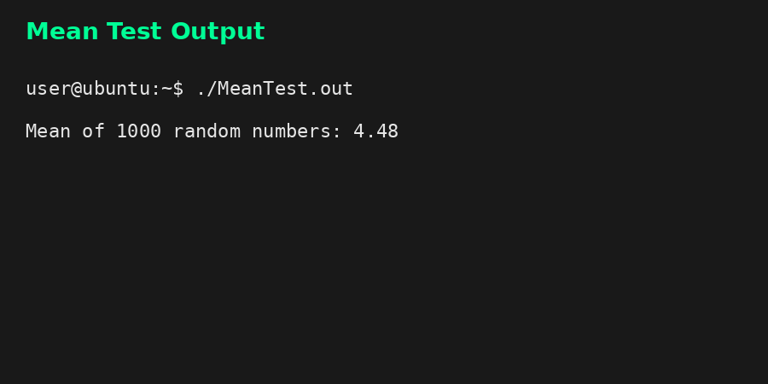
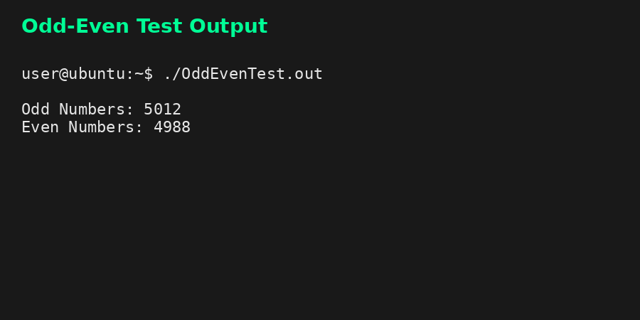
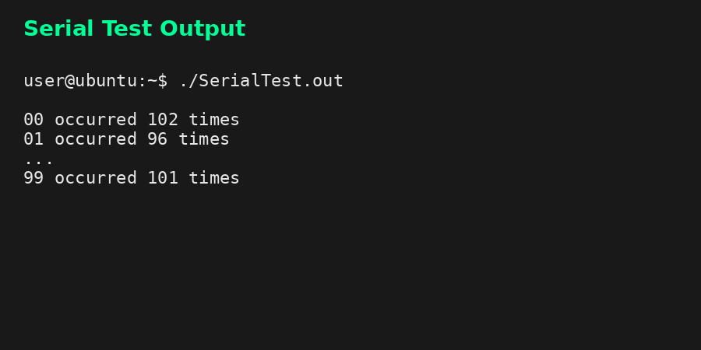
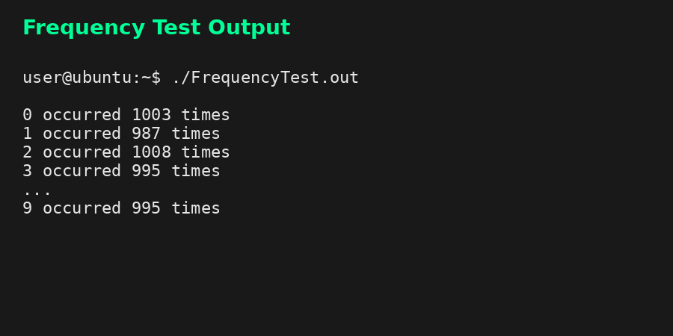

Slide 8
Conclusion
Summary of Learning Outcomes
Programming Skills Improved
The activity improved understanding of arrays, loops, counters, conditions, and random number generation. These skills are essential in secure software development.
IoT Security Relevance
Pseudo-random numbers are essential in encryption and secure communication within IoT systems. Secure random generation helps protect
connected devices from cyber threats.
Analytical Skills Developed
The tasks strengthened statistical analysis and problem-solving skills. Analysing generated data helped improve understanding of randomness and distribution.
Overall Outcome
The exercise provided practical programming experience relevant to IoT Systems Security. It also strengthened foundational knowledge required
in MSc Cyber Security.
Slide 7 | MSc Cyber Security – IoT Systems Security

